Slide 1

GROUP 71: PATHFINDER
ETHAN CALLANAN, MAX KANG,
RAMI BALLALOU, ADELA YANG
11.1.2020

Slide 2
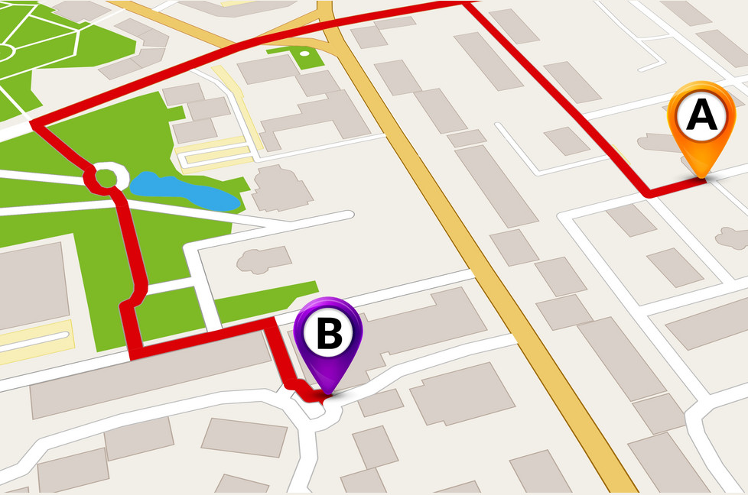
Summary
Pathfinding is a very relevant and useful AI application, especially with the advent of self-driving cars.
This project aims to assess if there is a possible path from a start point to an end point; as well as how many and what they all are . As in real life, there can be blockages and not all paths are valid.
A model will correspond a path of accessible squares; if no such model exists, then there is not a valid pathway from the start to finish.

Slide 3
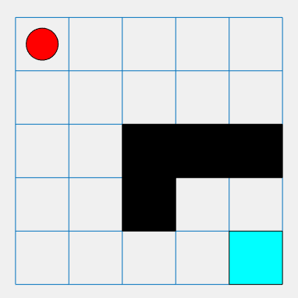
propositions
VARIABLES
Grid = [xij, …]: for squares in the grid. Each xij = True: if accessible, False: if inaccessible.
Path = [yij, …]: Each yij = True if the square obj is in the path, false if the square obj is not in the path.
Squares = [Square Objects] For each Square sq, sq.i is the row, sq.j is the column.
s = xij = True for starting location.
e = xij = True for ending location.
s
F
F
F
F
e

Slide 4
constraints
s ∧ e ∧ ¬uij ∧ aij
(Each uij is an inaccessible square, each aij is an accessible square)
yij is true IF if it's adjacent and xij is also true.
start is connected to end.
x11
y02
y24
Since x11 is true, and x11 is adjacent then y11 is true and belongs to a path.

Slide 5
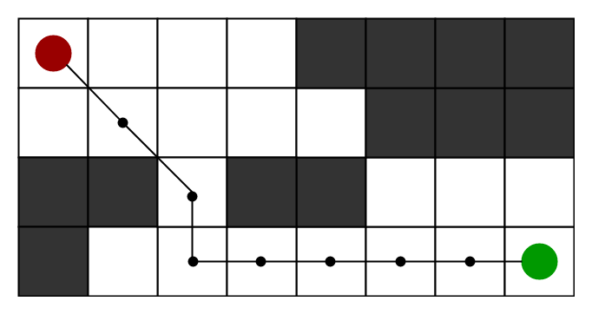
Model exploration
The notion of how we defined our grid and squares has changed. At first, we had a variable for each square, but we've found that using an object to hold all the squares with properties for the coordinates would be a lot cleaner and allow us to use mathematical operations on each object.
Another distinct change with our propositions and variables that we've made is setting start & end as a property of the Square object instead of an obscure variable, allowing us to set them as true or false for each square. Following the feedback given by Prof. Muise, we got rid of a constraint which ensured that each path proposition was true. We removed this constraint as it'd make our model way more optimized as this constraint would exist for each path possible, which could be millions theoretically. As advised by Prof. Muise, we also added more functionality to our model such as finding out how many paths exist, and what paths they are instead of just looking at whether there is a path. This would make our model more than just a one-dimensional project.

Slide 6
First order extension
The majority of our propositions and constraints follow a logic setting, however, there are several ways in which we could extend our model to a more logic setting. We could look into finding out the fastest path to trim down the solutions. Another way we could further extend our project is simulating real life streets using the Google Maps API and finding paths for real life scenarios.
We hope to experiment with blocking certain squares and seeing the impact on amount of paths remaining from start to end position, and what would the fastest path be if certain squares are blocked off.

Slide 7
Feedback
1. If possible, have a look at has_adj() function. -> How could we check if s is connected to e? (comment on line 139)
2. In regard to first order extension, how would we make our propositions and constraints a more logic predicate setting?

Slide 8

THANK YOU
Adela, Ethan, Rami, Max.

